Slide 1
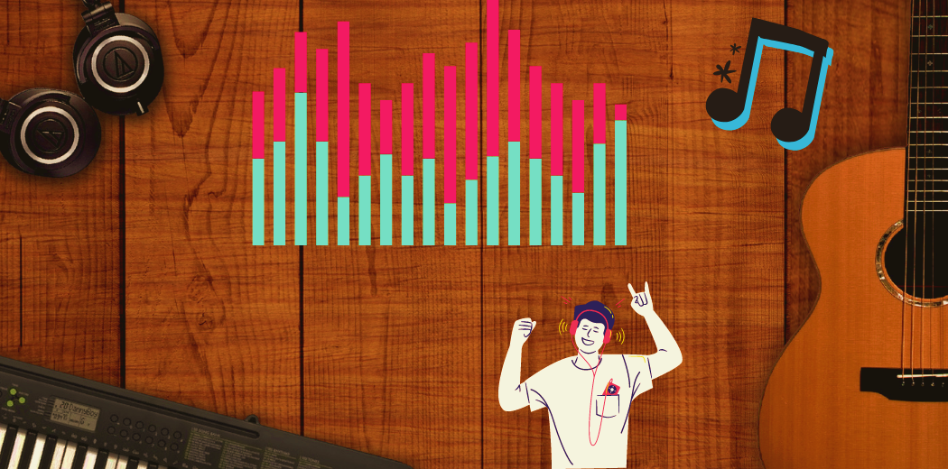
Music Genre Classifier using
Machine Learning
Presented By
J Sethuraman B.Tech Artificial Intelligence and Data science Sir Issac Newton college of Eng & Tech

Slide 2



AGENDA
1. Introduction
2. Data Collection and Preprocessing
3. Exploratory Data Analysis (EDA)
4. Model Selection
5. Model Training
6. Model Evaluation
7. Improving Model Performance
8. Deployment
9. Conclusion
3/21/2024 Annual Review

Slide 3

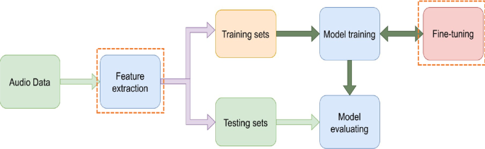
PROBLEM STATEMENT
Music is a universal language enjoyed by people across the globe, encompassing a wide range of genres such as rock, pop, classical, jazz, and many more.
With the rapid growth of digital music platforms and streaming services, there is a growing need for automated methods to organize and categorize music according to its genre.
A music genre classifier using machine learning can help in categorizing music efficiently, enabling better recommendations, playlist generation, and user experience enhancement.]
The objective of this project is to develop a machine learning model capable of classifying music tracks into predefined genre categories accurately. Given an input audio clip, the model should predict the most suitable genre label(s) for the music.

Slide 4

PROJECT OVERVIEW
The project aims to develop a machine learning-based solution for classifying music tracks into different genre categories automatically.
With the proliferation of digital music platforms and the vast diversity of musical styles, there's a growing need for efficient music organization and recommendation systems.
Build a robust machine learning model capable of accurately classifying music tracks into predefined genre categories.
Develop a user-friendly interface for users to interact with the genre classifier, allowing them to submit audio clips and receive genre predictions.
Deploy the trained model as a web application or API, enabling seamless integration with existing music platforms and services.

Slide 5

WHO ARE THE END USERS?
Music Enthusiasts: They might use the genre classifier through standalone applications, websites, or mobile apps to discover new music or categorize their existing music libraries.
Music Researchers and Analysts: Researchers, analysts, and musicologists could utilize the genre classifier for studying music trends, analyzing genre popularity, or conducting academic research in musicology and music psychology.
Radio Stations and DJs: Radio stations, DJs, and music curators might use the genre classifier to categorize music tracks for programming playlists, creating themed shows, or organizing music libraries.
Music Production and Licensing Companies: It could assist in identifying suitable tracks for specific projects, such as film soundtracks, commercials, or video games, based on genre classification.
Educational Institutions: Music educators and students studying music theory, composition, or production could benefit from the genre classifier as a tool for teaching and learning about different musical styles and genres.

Slide 6

YOUR SOLUTION AND ITS VALUE PROPOSITION
Our solution is a robust machine learning model trained to accurately classify music tracks into predefined genre categories. Leveraging state-of-the-art audio feature extraction techniques and machine learning algorithms, our model can analyze the unique characteristics of each music track and predict its genre with high precision.
Enhanced Music Discovery: Our Music Genre Classifier enables users to discover new music across different genres easily. By accurately categorizing music tracks, users can explore diverse genres and expand their musical horizons.
Personalized Recommendations: Integrated into music streaming platforms and applications, our classifier provides personalized recommendations based on users' music preferences and listening history. By understanding users' genre preferences, the platform can curate tailored playlists and suggest relevant music content, enhancing user engagement and satisfaction.
Efficient Music Organization: For DJs, radio stations, music production companies, and educators, our classifier simplifies the process of organizing and categorizing music libraries. By automating genre classification, users can efficiently manage large volumes of music tracks, streamline playlist creation, and enhance workflow efficiency.

Slide 7
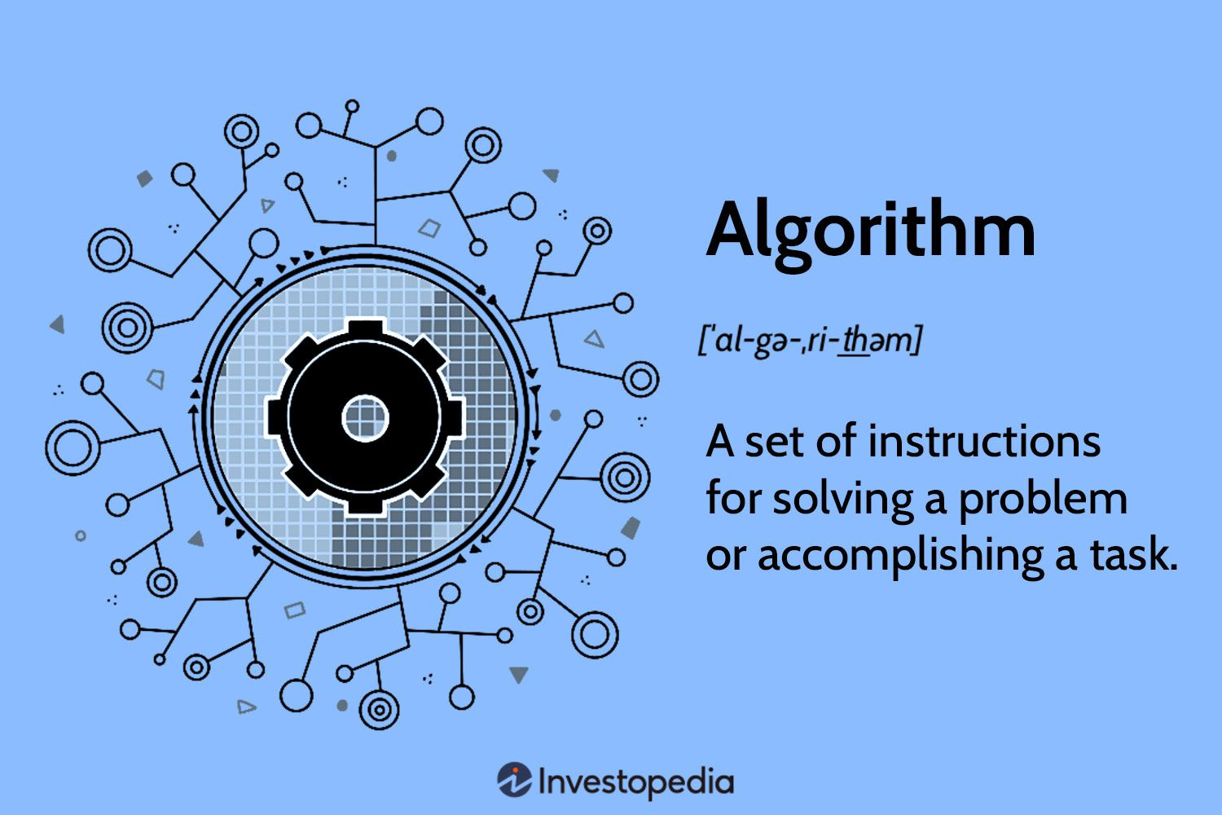
Algorithms we used
K-Nearest Neighbor
Naive Bayes
Support Vector Machines
Adaptive Boosting
Classification via Regression
Linear Logistic Regression

Slide 8
Improving Model Performance
Feature Engineering: Extracting relevant features from the audio data can significantly impact the performance of your model.
Balanced Dataset: Ensure that your dataset is balanced across different genres to prevent the model from biasing towards over-represented classes.
Model Architecture: Experiment with different architectures such as Convolutional Neural Networks (CNNs), Recurrent Neural Networks (RNNs), or hybrid models like Convolutional Recurrent Neural Networks (CRNNs).
Regularization: Apply techniques like dropout or L2 regularization to prevent overfitting, especially if you have a limited amount of training data.
Domain-Specific Knowledge: Incorporate domain-specific knowledge about music and genres into your model design and feature engineering process.

Slide 9

THE WOW IN YOUR SOLUTION
State-of-the-Art Accuracy: Our Music Genre Classifier is trained on vast and diverse datasets, utilizing cutting-edge machine learning techniques to achieve remarkable accuracy in genre classification.
Real-Time Performance: Unlike traditional genre classification systems that may suffer from latency issues or processing delays, our solution operates with lightning-fast speed, delivering real-time genre predictions instantaneously.
Scalable Deployment: Built with scalability in mind, our solution is designed to seamlessly scale with user demand, supporting millions of users and processing vast volumes of music data effortlessly.
With its groundbreaking performance and wide-ranging applications, our solution sets a new standard for automated music genre classification, leaving users awestruck with its transformative impact on the way they discover, explore, and enjoy music.
9

Slide 10
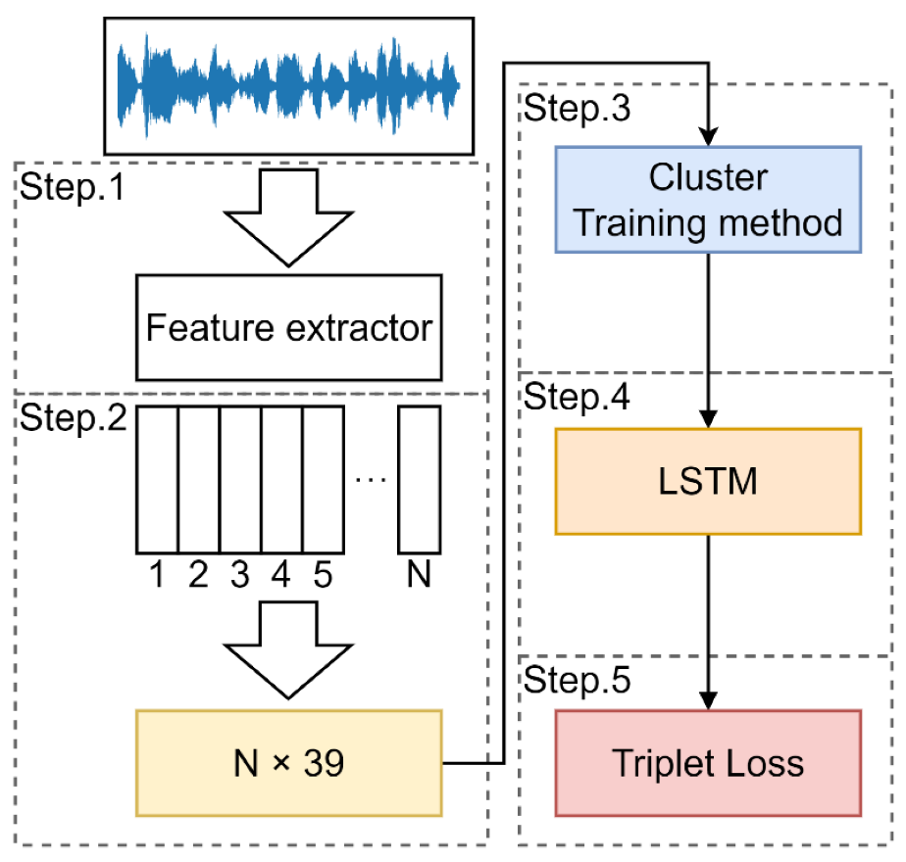
MODELLING
Teams cam add wireframes
1. Model Selection:
Random Forest
Support Vector Machines (SVM)
2. Feature Extraction:
Mel-Frequency Cepstral Coefficients (MFCCs)
Spectrograms
3. Data Splitting:
Split the dataset into training, validation, and test sets.
4. Hyperparameter Tuning:
Fine-tune the hyperparameters of the selected model(s) using techniques like grid search, random search, or Bayesian optimization.
10

Slide 11
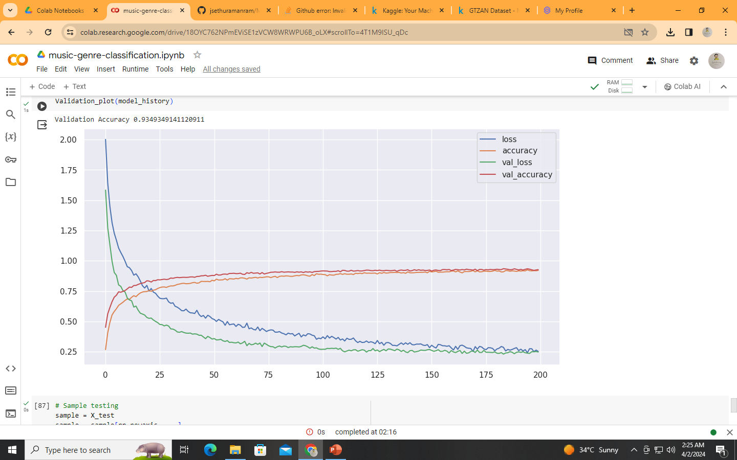
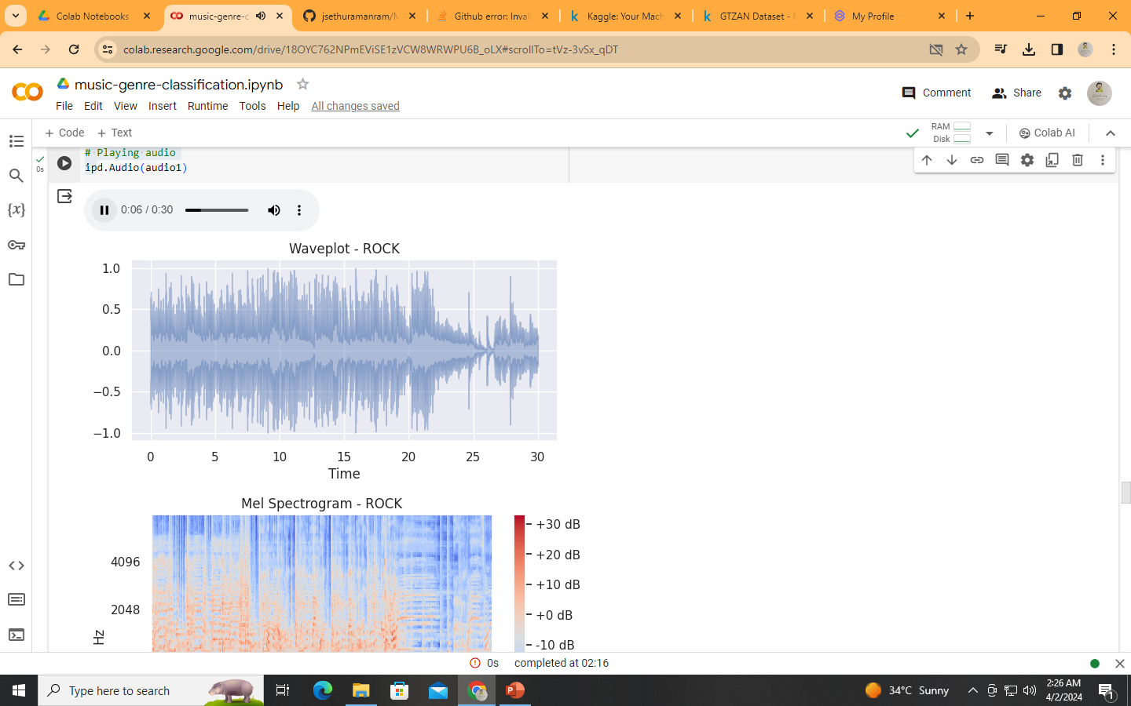
RESULTS
Demo Link
11

Slide 12

Reference :
https://github.com/jsethuramanram/Music-Genre-Classification.git
Contact :
jsethuraman44@gmail.com

